Slide 1
Book Store Management System

Slide 2
Contents
Introduction to Book Store Management System
Frontend : Thyme leaf
Backend : Spring Boot , JAVA, Maven
Technologies used
Objective
Requirements
Screenshots
Page1 : Home
page2 : Available Books
Page3 : New Book Register
Advantages
Conclusion

Slide 3
Introduction to Book Store Management System
Book store management system is the computerize application to automate all kinds of activity in book store.
The main aim of this software is to manage the books in the book store.
To search records of a book efficiently.
Processing a large amount of data effectively and efficiently.
To provide better service.
It keeps database of book details, price, Customer record.

Slide 4
Frontend : Thyme leaf
Thymeleaf is a Java-based template engine that allows to build dynamic pages using templates written in XML, XHTML or HTML.
The engine provides a very pleasant way to inject logic into the templates. It uses XML tags and attributes just like HTML pages so even without starting web container we can check how the static page will look when it will be rendered.
The engine allows a parallel work of the backend and frontend developers on the same view.
Thymeleaf is an engine based on XML attributes.
The engine evalutes values from attributes to build a DOM tree.

Slide 5
Thymeleaf Attributes
Constructing URLs in Thymeleaf (th:href)
Using th:each in Thymeleaf (th:each)
Using conditions in Thymeleaf(th:if,th:switch)
Create data-* attribute with Thymeleaf(th:attr)
Working with Forms in Thymeleaf (th:action,th:field)
Using Enums in Thymeleaf(T)
Working with local variables in Thymeleaf (th:with)
Working with Thymeleaf dialects (fbe:header,fbe:welcome)

Slide 6
Backend : Spring Boot
Creating Spring boot using spring boot initializer.
Spring Boot automatically configures your application based on the dependencies you have added to the project .
Dependencies that added in my project are:
Spring web
Thymeleaf
Spring Data JPA
MySql database
Devtools

Slide 7
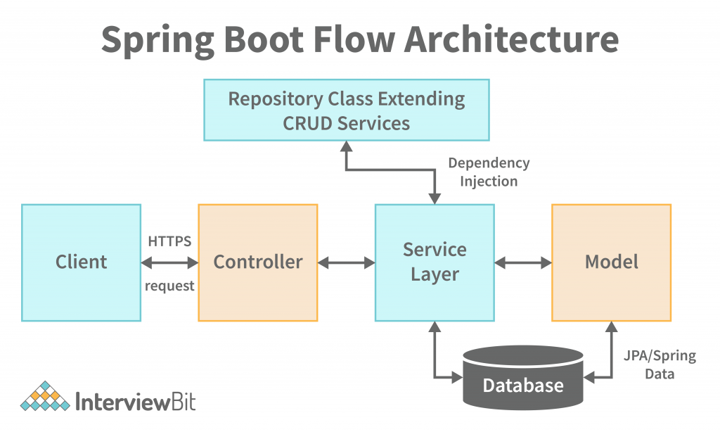
Spring Boot Architecture

Slide 8
Spring Boot
Spring Boot is an open source java-Based framework used to create a micro service. It is developed by pivotal team and is used to build stand-alone and production ready spring application.
Micro Service is an architecture that allows the developers to develop and deploy services independently.
Advantages of Micro Service :
Easy deployment
Simple scalability
Compatible with containers
Lesser Production time
Minimum configuration

Slide 9
Backend : JAVA
Java is a widely used object-oriented programming language and software platform that runs on billions of devices, including notebook computers ,mobile devices and many others .
When the language was invented in 1991 by James Gosling of sun microsystems(later acquired by oracle), the primary goal was to be able to “write once,run anywhere.”
The rules and syntax of java are based on the C and C++ languages.
One major advantage of developing software with java is its portability.Once you have written code for a java program on a note book computer it is very easy to move the code to a mobile device.

Slide 10
Backend : Maven
Maven is a powerful project management tool that is based on POM(project object model).
It is used for project build, dependency and documentation.
Current Version of Maven is 3.
It makes a project easy to build.
It provides uniform build process(maven project can be shared by all the maven projects).
It provides project information (log document, cross referenced sources, mailing list, dependency list, unit test reports).

Slide 11
Technologies And Tools
Spring Boot
Java
Maven
Thymeleaf
MySql
Bootstrap

Slide 12
Objectives
The main objective of book online book store is to manage the details of Books, Customer, Price.
The book store management system application will help in maintaining all the details at one stretch.
This project will be very useful for the people having the huge book stores.
This project will provide the customers with online shopping facility through a web browser.

Slide 13
Requirements
Hardware requirements
Processor – i3
Hard Disk –8GB
Software requirements
Windows 11
MySql work bench
Eclipse 2022

Slide 14
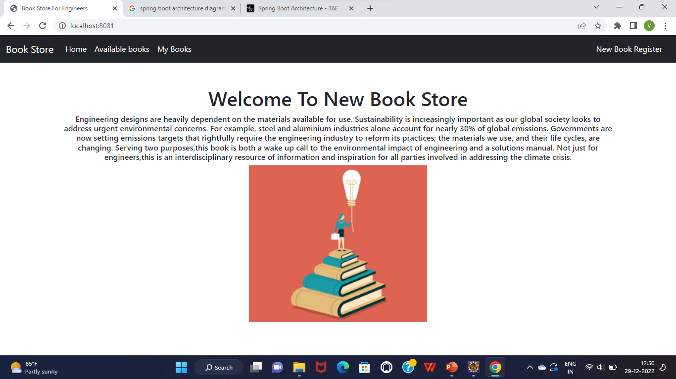
HOME PAGE

Slide 15
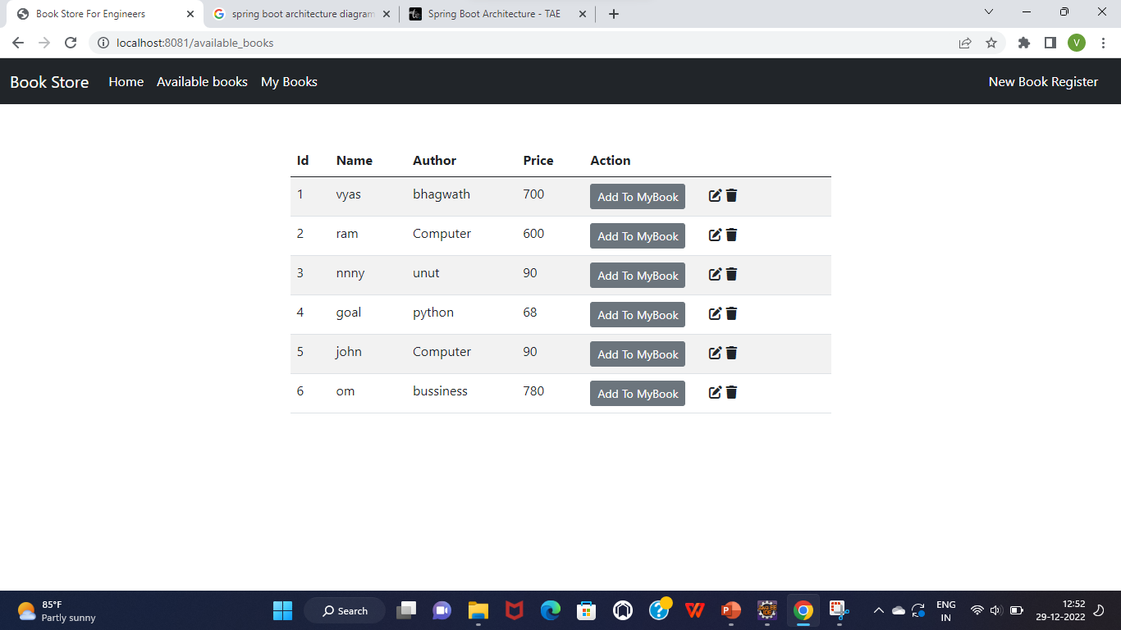
Available Books Page

Slide 16
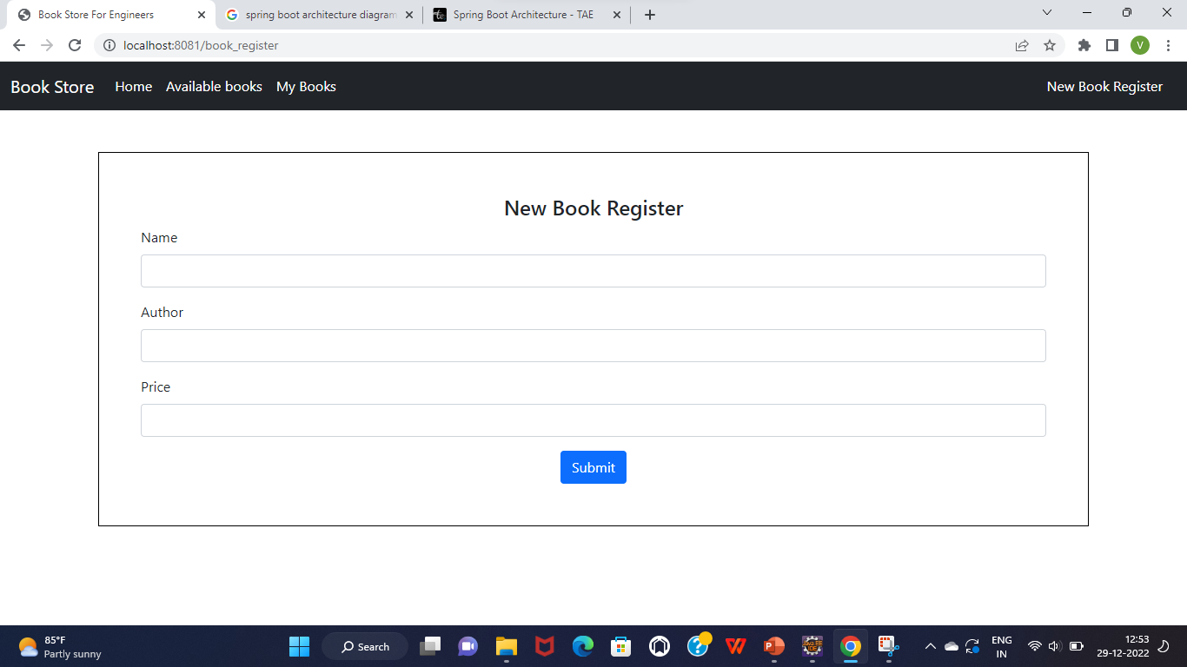
New Book Register Page

Slide 17
Advantages
Customers can get their book delivered instead of actually going and buying the book. They can make payment online itself.
This system saves both time an travelling cost of customers.
User can get to know different kinds of books that they were unware of by just searching in the system using keywords.

Slide 18
Conclusion
Online book store is an online web application where the customer can purchase books online. Through a web browser , Customers can search for books by its author.

Slide 19
Thank you

